Slide 1
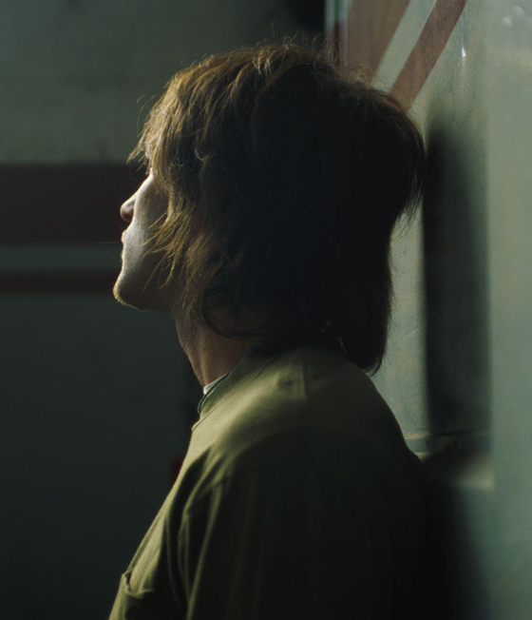
Chapter 15
Psychological Disorders

Slide 2
Schizophrenia
Is schizophrenia the same as “split personality”?
Notes:
2

Slide 3
Dear Sirs,
Pertaining to our continuing failure to prosecute violations of minor’s rights to sovereign equality which occurring in gestations being compromised by the ingestation of controlled substances, …the skewing of androgyny which continues in female juveniles even after separation from their mother’s has occurred, and as a means of promulflagitating my paying Governer Hickel of Alaska for my employees to have personal services endorsements and controlled substance endorsement,… the Iraqi oil being released by the United Nations being identified as Kurdistanian oil, and the July, 1991 issue of the Siberian Review spells President Eltsin’s name without a letter y.

Slide 4
Schizophrenia
Devastating Psychological disorder characterized by major disturbances in thought, perception, emotion, and behavior
1% of population experiences during lifetime
Diagnosed around Early Adulthood
Difficulty in performing day to day activities
No split personality
Psychotic Disorder
Notes:
Day to day activites: holding a job, hygeine,

Slide 5
Symptoms of Schizophrenia
Hallucinations:
- Auditory hallucinations are common
Delusions:
Paranoid, Grandiose, and Somatic delusions
Disorganized Thinking:
Disorganized or Abnormal motor behavior:
Negative Symptoms:

Slide 6
Causes of Schizophrenia
Genetic Based
Adoption studies
Biological mothers had schizophrenia
Increased risk of developing it later on in life
Genes and Environment
More likely to develop if high for genetic risk and raised in bad family environment
Diathesis-Stress interpretation
Neurotransmitter:
- Overabundance of dopamine or too many dopamine receptors leads to onset/maintenance of the disorder

Slide 7
Brain Anatomy
Those with schizophrenia have
Enlarged ventricles
Cavities containing cerebral spinal fluid
Possible brain abnormalities due to events during pregnancy
Certain environmental factors
Exposure to influenza
Mother’s emotional stress
Mother experiencing death of someone during first trimester

Slide 8
Dissociative Disorders
Individual becoming split off from her core sense of self
Notes:
8

Slide 9

Dissociative Amnesia
Unable to recall important personal information, usually following an extremely stressful event.
May also experience dissociative fugue.
The validity of dissociative amnesia:
- still debatable.
Notes:
…traumatic experience such as combat, natural disaster, or being the victim of violence.
Will also experience dissociative fugue, in which case the person suddenly wanders away from one place, experiences confusion about his/her identity, and sometimes even comes up with a new identity. It’s like you are sitting in the classroom, suddenly stand up start walking around, telling other students to do push-ups, because you forget you’re a student and think yourself as a military commander.
Not a lot of cases can be found. Others suggested that it is underdiagnosed, especially in psychiatric population.

Slide 10

Dissociative Identity Disorder
Formerly known as multiple personality disorder
Exhibit two or more separate personalities or identities.
Notes:
Perhaps a more better known dissociative disorder is DDI. A guy named George, who is a likeable salesman working in a car dealership. He suffers from DID, and his other personality/identity is Russian spy living in the U.S. to gather intelligence. When his salesman identity is in charge, he has not idea about the other identity.

Slide 11
Dissociative Identity Disorder
Has been controversial:
Some people fake symptoms to avoid the consequences of legal actions
Rates of the disorder skyrocketed in the 80s, suggesting that clinicians might have overdiagnosed the disorder
It is real, and may become extreme
Sufferers have experienced events they would like to forget or avoid
Notes:
1. “I’m not responsible for stealing because it was my other identity which I have no idea about!”
Kenneth Bianchi, an infamous seriel killer, murdered over a dozon females around LA in the 70s. At his trial, he pled not guilty by reason of insanity, pretending he had DID and claiming that a different personality committed all the murders. He later admitted faking the symptoms of DID and was found guilty.
2. More cases of DID were identified during the 5 years prior to 1986 than in the preceding 20 years. In 1970s, a popular book Sybil was published. The popularization of DID may have prompted clinicians to overdiagnose the disorder.

Slide 12
Personality Disorders
Notes:
12
Another important category in DSM-5. Ppl with personality disorders exhibit a personality style that differs remarkably from the expectation of their cultures. They usually display personality styles that are very troubling, creating problems for themselves and others.

Slide 13
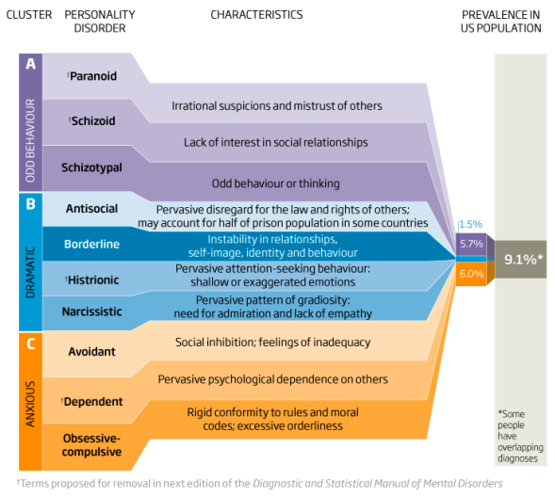
DSM-5 Personality Disorder
Notes:
DMS-5 recognized 10 personality disorders, organized into 3 clusters.
A: odd or eccentric
B: impulsive, overly dramatic, highly emotional
C: nervous and fearful

Slide 14
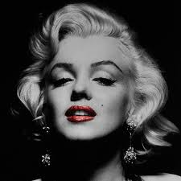
Borderline Personality Disorder
Can’t tolerate being alone
Do extreme things to avoid abandonment
Have intense and unstable relationships
Have unstable view of self
Highly impulsive and self-destructive
Affects about 1.4% of the U.S. population
Notes:
BPD is characterized by instability in interpersonal relationships, self-image, and mood.
Marilyn Monroe:
She married her first husband, a merchant marine at the age of 16, and divorced him 4 years later. Her second marriage to a baseball player was over in 9 months. Her third marriage ended in 5 years. As her 3rd husband described, she probed the world for the slightest sign of hostility and constantly sought reassurance. He had expected the happy girl that all men loved but discovered someone diametrically opposite, a troubled women whose desperation was deepening no matter were she turned for a way out.”

Slide 15

Antisocial Personality Disorder
Show no regard at all for other’s rights or feelings
View the world as self-serving and unkind.
Notes:
Most of use live with a moral compass, telling us what is right and what is wrong. Ppl with APD, however, do not seem to have one. They act as if they neither have a sense of nor care about right or wrong.
Repeatedly performing illegal acts, lying to or conning others
Very impulsive, reckless, irritable, aggressive toward others
No remorse over misdeeds: they will hurt, manipulate, and abuse others, without feeling any guilt.
They believe they should do whatever works to get by in life. Tend to view others not as humans, but rather as tools they can use for some purposes.
They also lack empathy: incapable of understanding the emotion of others.

Slide 16
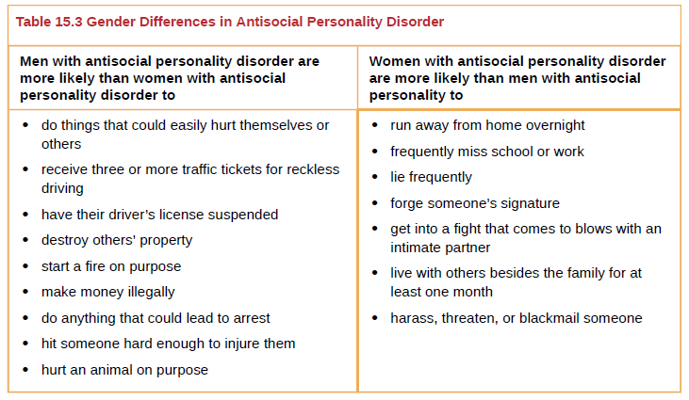
Antisocial Personality Disorder

Slide 17
Antisocial Personality Disorder
Genetic factors influence its development.
Environmental factors influence its development.
Parental criminality
Family conflict
Peer delinquency
Gang membership
Disorganized community
Availability of drugs
Etc.
Notes:
Twin and family studies suggest that APD kinda runs in the family to some extent. Not surprisingly, many children whose parents have APD have to be put up for adoption. If they were raised in adverse adoptive family environment, they are more likely to also develop APD than if they were raised in normal adoptive environment.

Slide 18
Disorders in Childhood
Notes:
18

Slide 19
Attention Deficit/Hyperactivity Disorder (ADHD)
First described by Hans Hoffman in 1920s.
Inattention:
Avoid tasks that require sustained attention
Can’t follow instructions
Lack of attention to details
Easily distracted
Hyperactivity:
Excessive movement
Hasty, impulsive, act without much thinking.

Slide 20
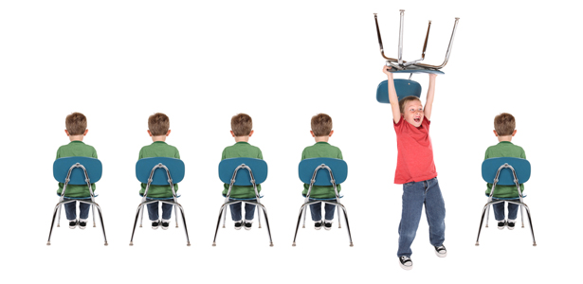
Attention Deficit/Hyperactivity Disorder (ADHD)
Affects about 5% of children.
Boys are 3 times more likely to have it.
Associated with long-term negative life outcomes.
Notes:
ADHD doesn’t simply fade away by adolescence. Many adults still have the symptoms of ADHD.
135 adults who had been identified as having ADHD in the 70s were contacted 3 decades later. Compared to those who had never had ADHD, these 135:
Had worse educational achievement.
Lower SES, held less prestigious occupational positions.
More likely to be employed, less salary
Perform worse at work, lower job satisfaction, poorer work relationships.
More likely to divorce, had fewer friends

Slide 21
Attention Deficit/Hyperactivity Disorder (ADHD)
Genetics plays a significant role in its development – very heritable.
Genes regulating dopamine are responsible.
Abnormality (smaller) frontal lobes.
Exposure to cigarette smoke during prenatal period is associated with ADHD.

Slide 22

Autism Spectrum Disorder
Deficits in social interaction
Deficits in communication
Repetitive patterns of behavior or interests.
Notes:
can’t initiate conversations with others; do not make eye contact and seem to prefer playing alone. It’s like they live in their own isolated social world.
Can range from a complete lack of speech, to one word responses, to echoed speech, to difficulty maintaining a conversation because they can’t reciprocate others’ comments.
Engage in repetitive movements, such as rocking, repeatedly dropping an object and then picking it up; show great distress at small changes in routine.

Slide 23
Autism Spectrum Disorder
Nearly 1 in 88 children in the U.S. has autism.
5 times more common in boys.
Factors contributing to autism
Genetics
Environmental factors, such as exposure to certain pollutants, vitamin D deficiency
But NOT the MMR vaccine!
Notes:
In the late 1990s, a prestigious medical journal published an article showing that autism is trigger by the MMR vaccine, which drew a great deal of publish attention. People started questioning whether children should be vaccinated or not. However, the article was retracted from the journal a few years later, because the lead researcher who published the article might have fabricated the results. Even the results were faked, the rumor that vac can lead to autism is still being circulated in popular media and some people still believe there’s a link between the two. Multiple scientific studies have demonstrated that there’s no such a relationship.

